Slide 1
OctopusTale
Crafting Digital Excellence!

Slide 2
What we do
Design
We craft visually stunning and user-centric designs.
Build
We skillfully develop robust digital solutions.
Market
Our marketing approach ensures your brand stands out.

Slide 3
Our Services
UI/UX Design
Creating seamless and engaging user experiences.
Web App Development
Empowering businesses with robust online solutions.
E-commerce
Transforming digital storefronts into thriving marketplaces.
Mobile App Development
Crafting innovative mobile experiences.
Sports Tech
Innovating sports industry tech for enhanced performance and fan engagement.
Fintech
Revolutionizing banking and payments with secure digital solutions.
.
…and much more!

Slide 4
Our Works

Slide 5
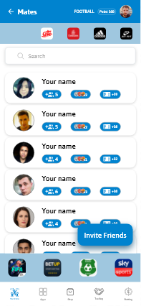
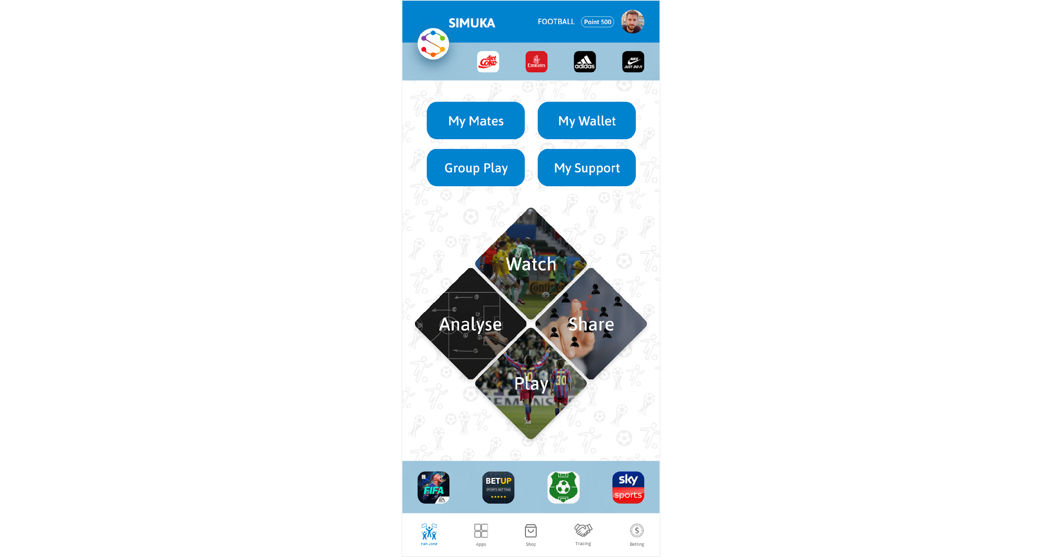
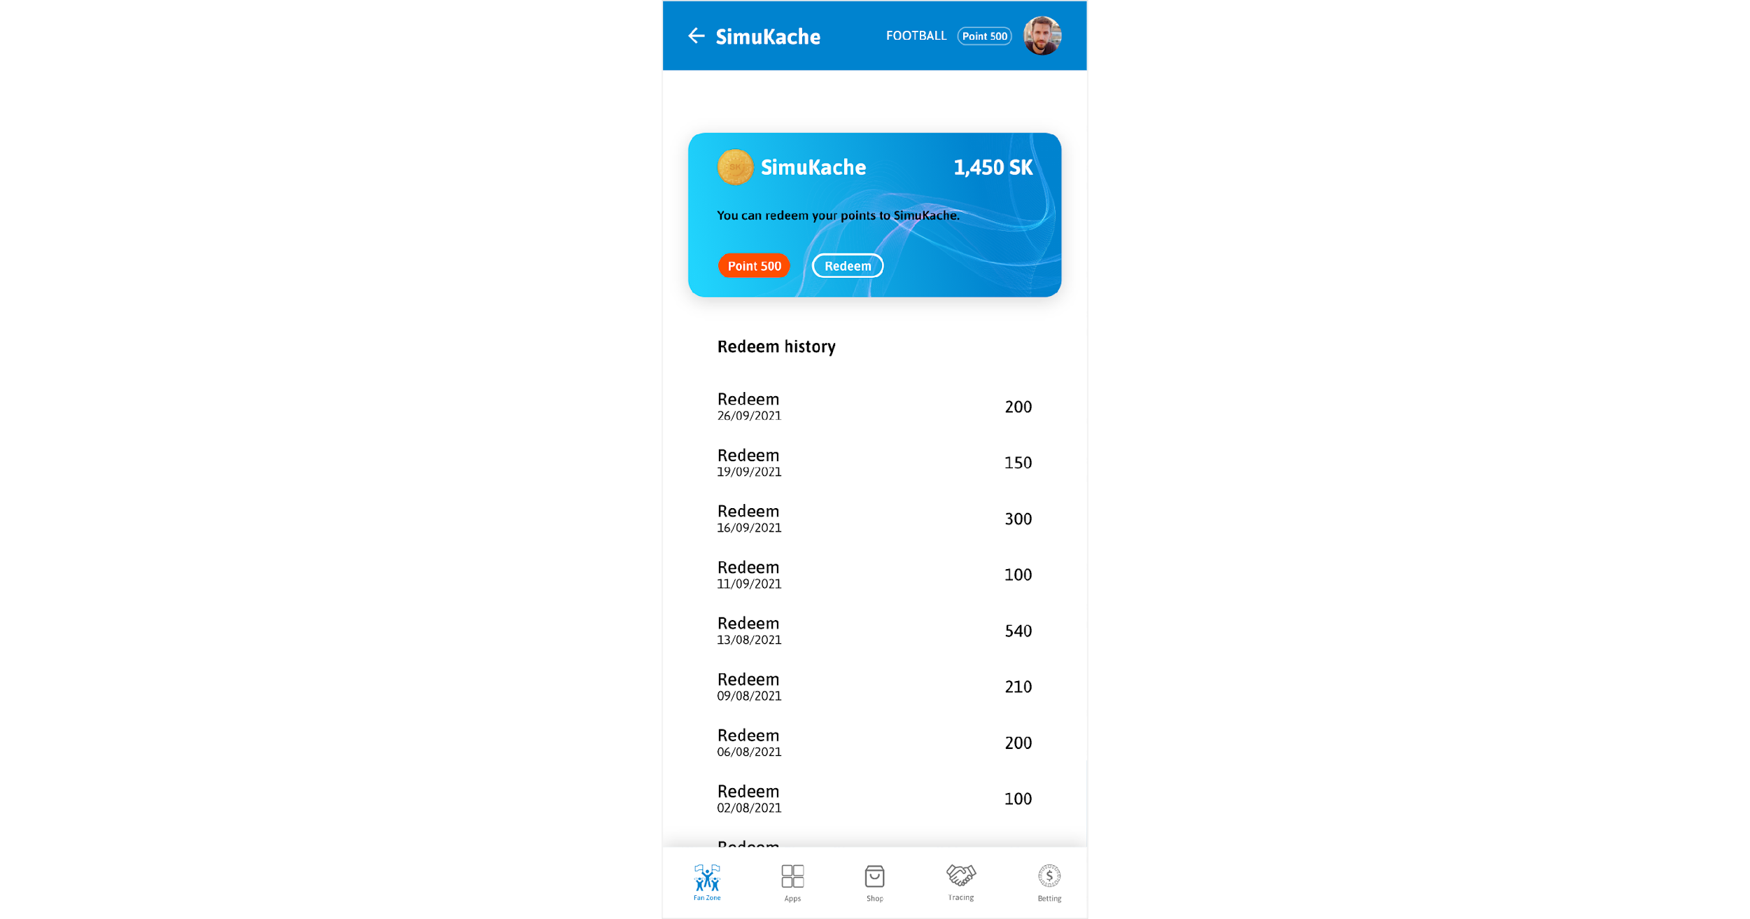
Simuka Football: Mobile App
SIMUKA Football represents a groundbreaking fan engagement app designed for a discerning client. The aim was to revolutionize fan engagement by offering zero-rated mobile access in key African markets, catering to millions of football enthusiasts aged 18-35.
Key Features
Live match/event streaming
Social Posts & Chat groups
Gamified community engagement
Zero rated access

Slide 6
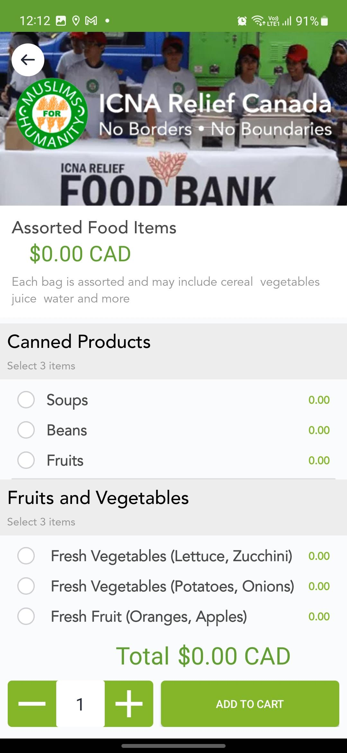
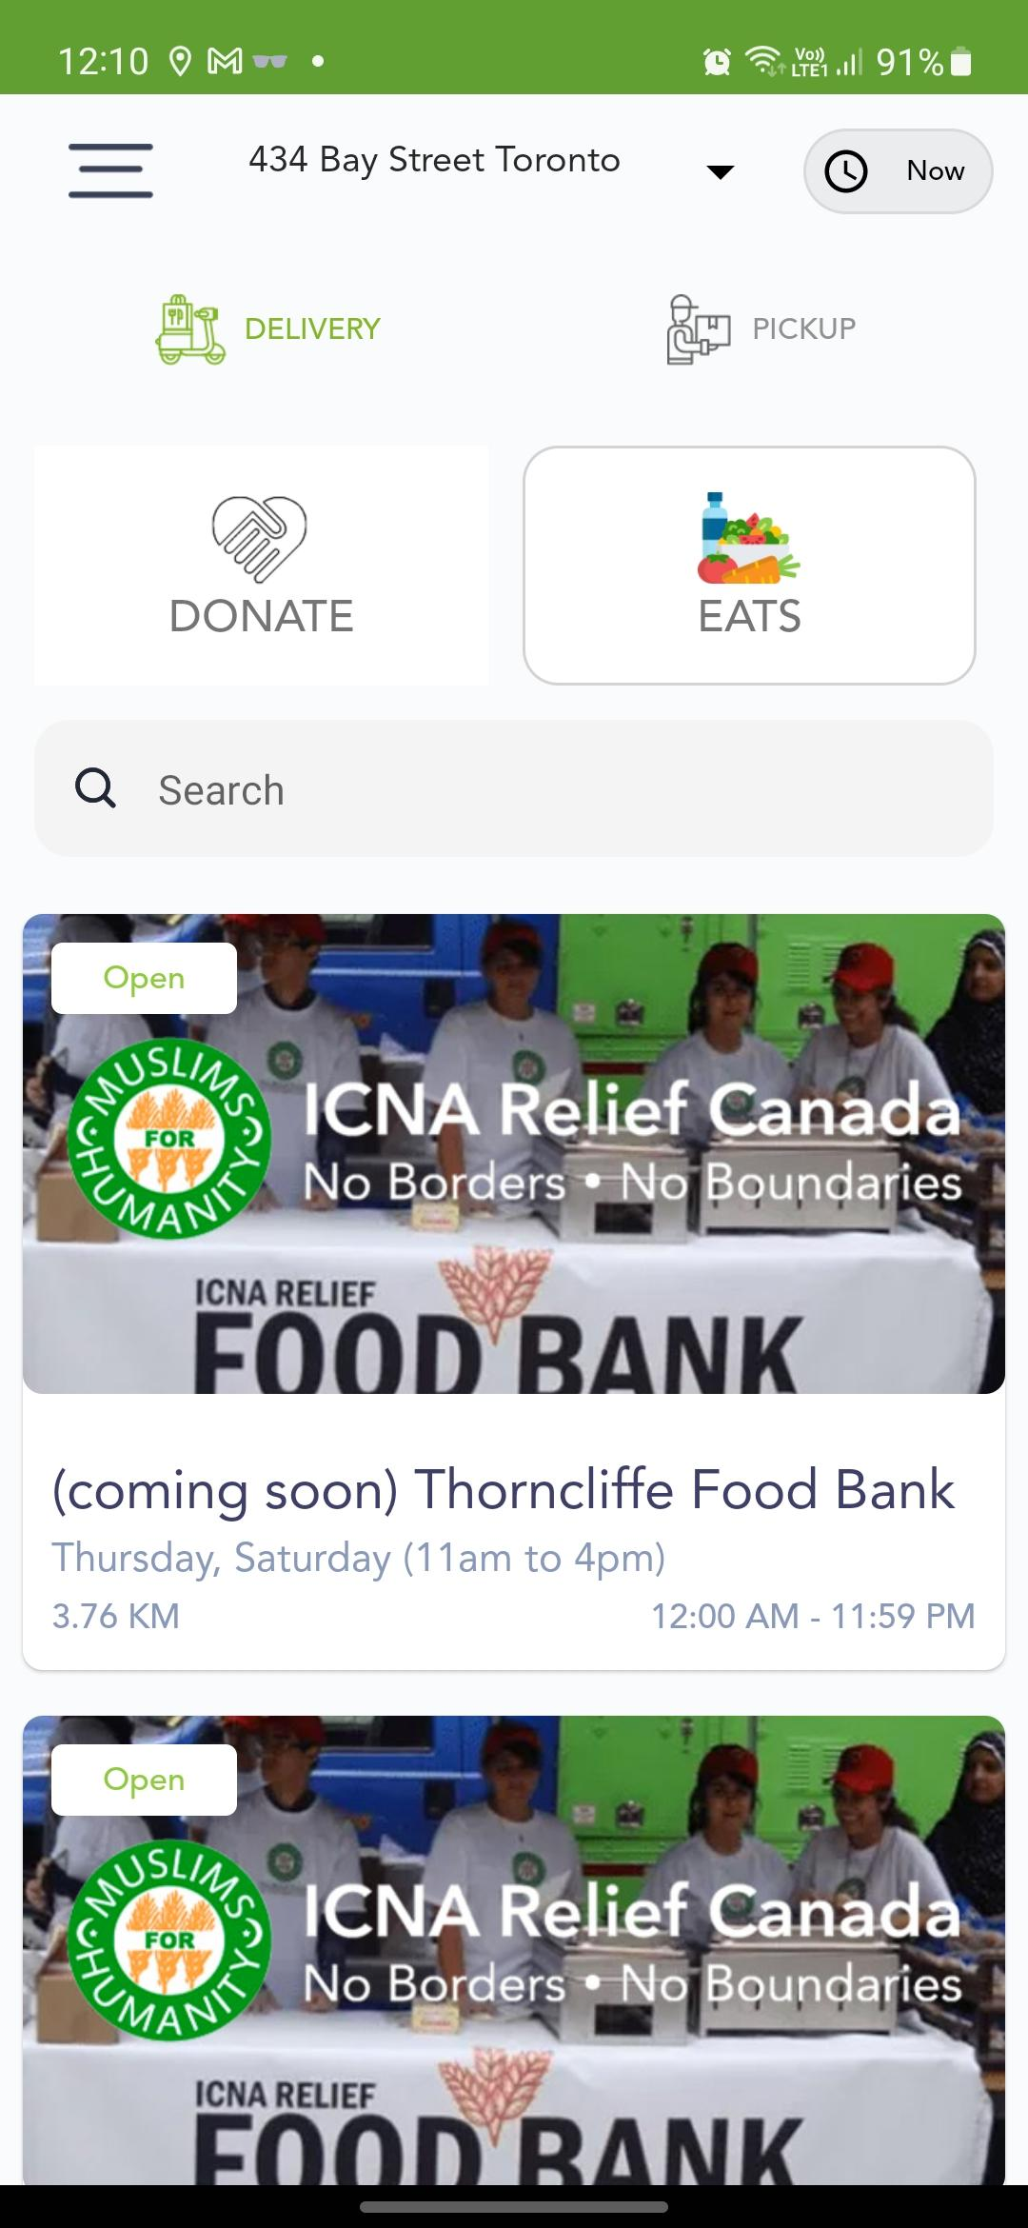
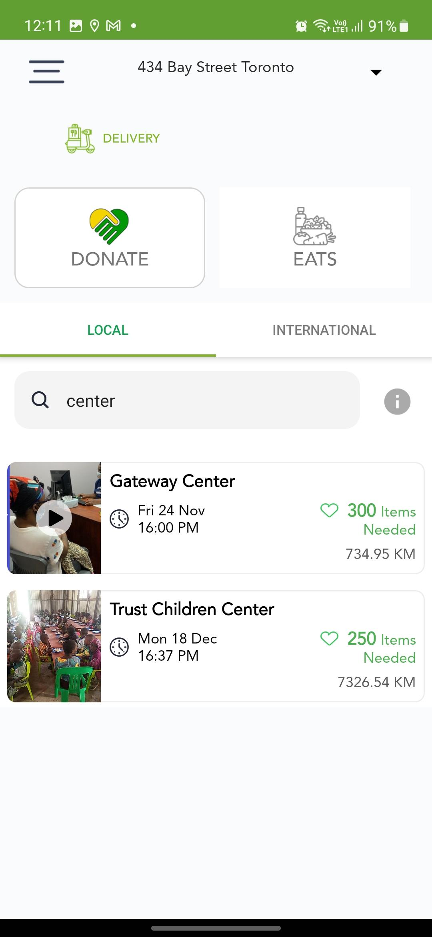
XP Eats: Mobile App
XP Eats is an innovative Mobile Meal Gifting platform designed to connect donors with local suppliers for gifting meals and products to those in need. The objective was to streamline generosity, minimize waste, and ensure seamless delivery to charities, providing instant verification for every donation.
Key Features
Meal Ordering & Delivery
Meal Gifting & Donations
People and Community focused

Slide 7
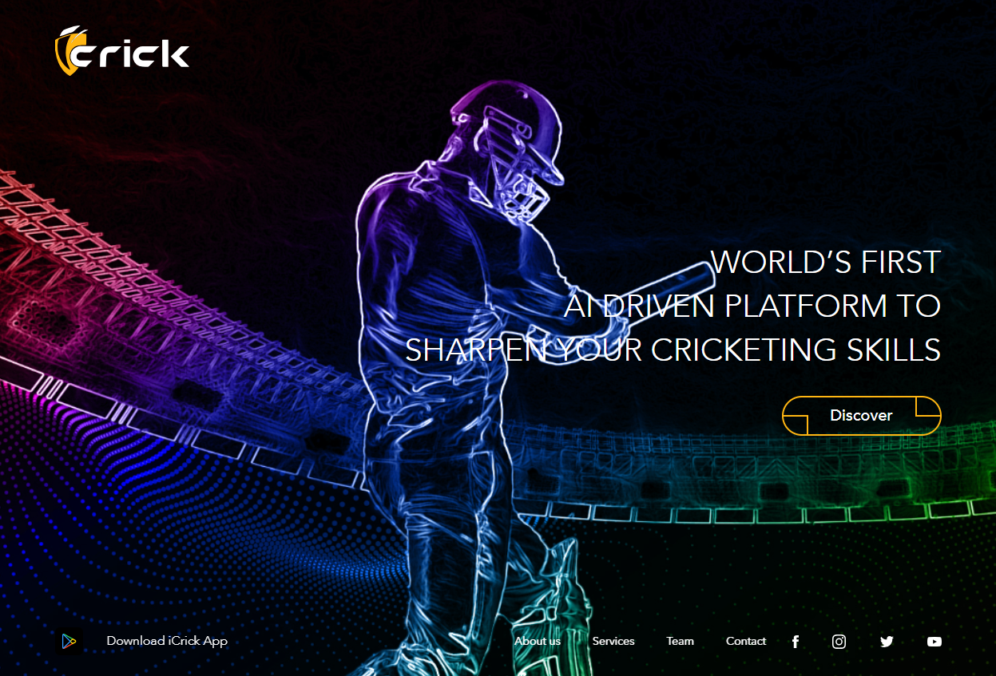
iCrick: Mobile App
The world’s leading Artificial Intelligence enabled application for cricket mentorship and access to vast amount of intellectual property content on cricket
Key Features
E-mentoring
Direct Coaching
White Labelling
Live Score

Slide 8
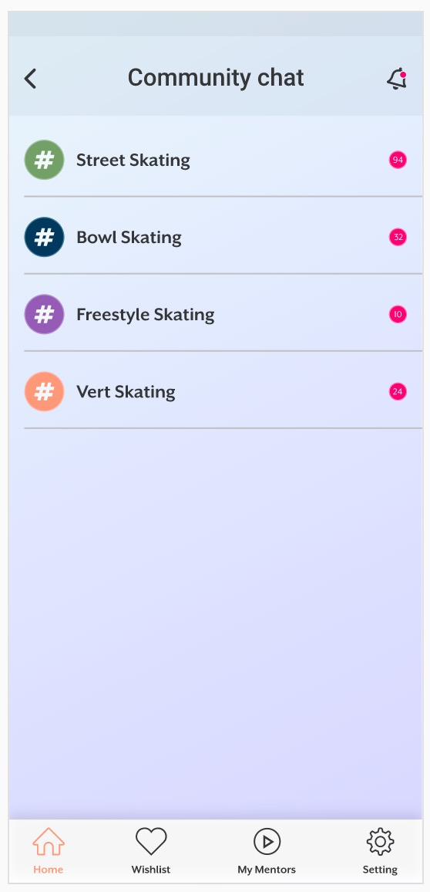

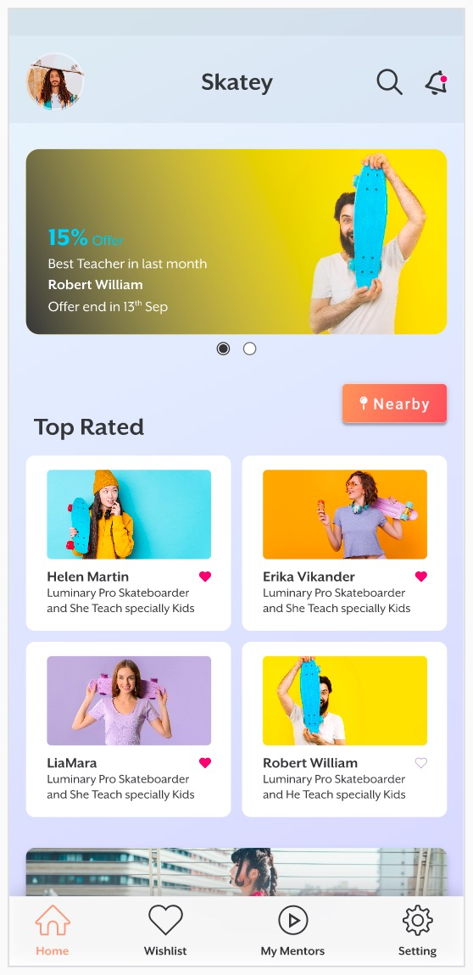
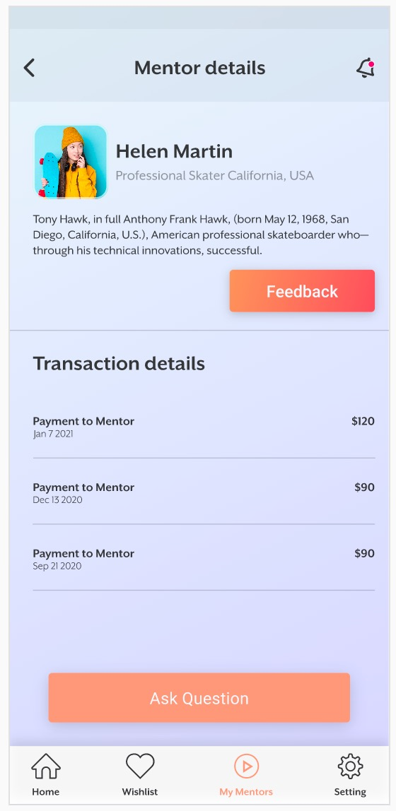
Skatey: UI Design
Skatey is a fan engagement platform crafted by skate enthusiasts for skate enthusiasts. The platform offers live e-Mentoring and a Group Mentoring platform, aimed at fostering the growth of future champions.
Partnership with renowned Canadian skater Jessy Jean Bert, adding excitement and expertise to the community.
Key Features
Live e-Mentoring and Group Mentoring
Dynamic chat groups
Social posts, and live events

Slide 9
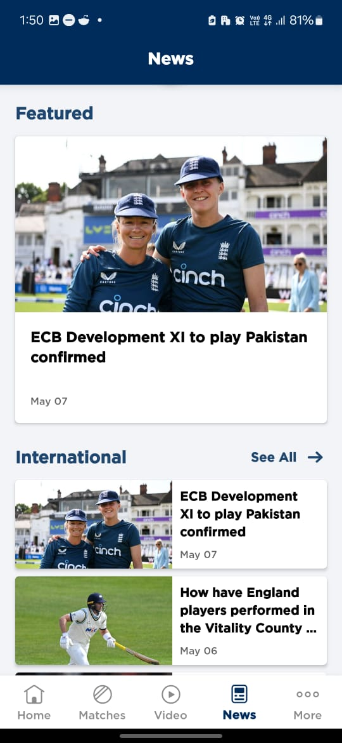
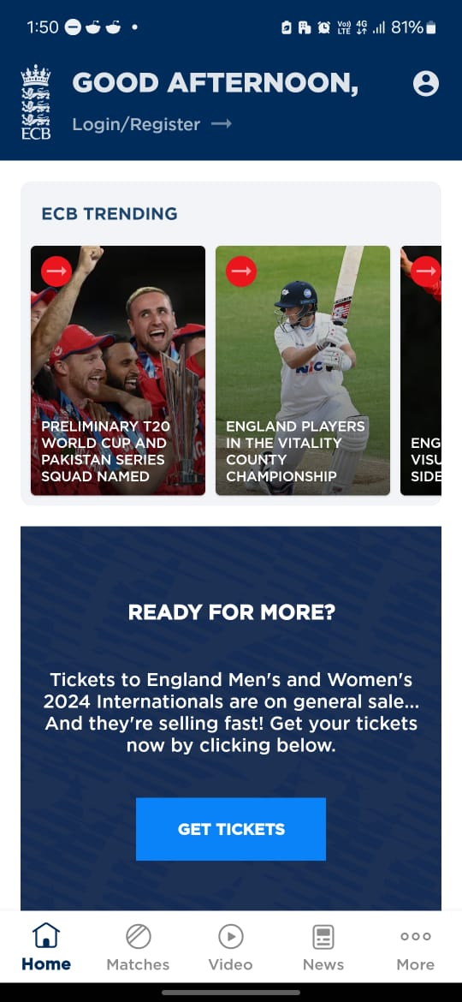
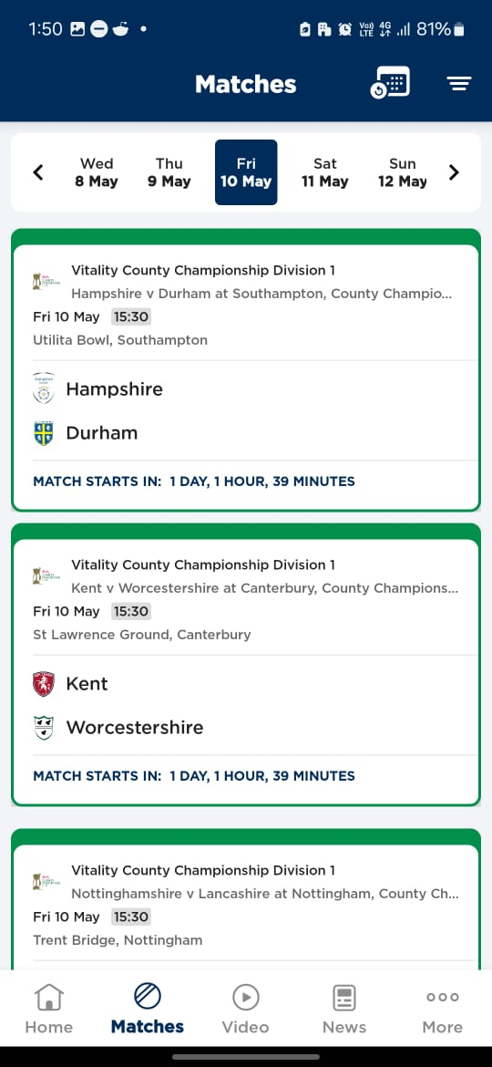
England Cricket England and Wales Cricket Board: Mobile App
The England Cricket mobile app is a project we delivered for the ECB.
Whether you are a fan, coach, recreational player, volunteer or many of these things – The app will give you even more from the sport you love.
Key Features
Latest news and video
Live scores, team line-ups, scorecards.
Integrated videos
New Matches area
League Tables

Slide 10
England Cricket Cricket South Africa (CSA): Mobile App
The Cricket South Africa app is the official mobile application for following cricket in South Africa. It's a great resource for cricket fans who want to stay up-to-date on all the latest news, scores, and statistics.
Key Features
Exclusive news and video
Follow Players and Teams
Live scores, team line-ups, scorecards.
Integrated videos

Slide 11
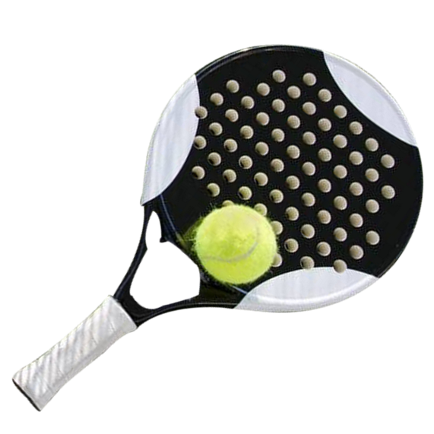
Padel - Real time Health
Monitoring Device
Player Data
ECG
Heartbeat
Grip Force
VO2 max
SPO2
Arm movement
Arm speed
Ball impact efficiency
Spin control
Racket tuning
Racket efficiency

Slide 12

Player Data
Realtime efficiency analysis
Fatigue monitor
Recovery monitor
Muscle strain measure
Blood oxygen level
Diet monitoring
Endurance
Muscle strength improvement
Weakness areas
Technical corrections
Racket management
Stress Factor
Strain Factor
Environment effect
Movement efficiency
Past match comparative study
Multivariable improvement analysis

Slide 13
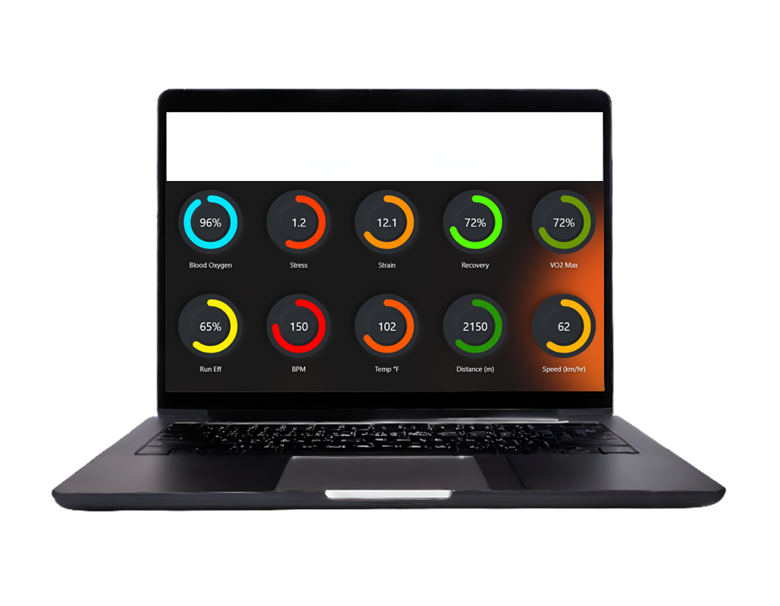

Slide 14
“
We believe in the transformative power of digital innovation. We believe that every business, regardless of size, deserves to thrive in the online realm.
Our mission is to empower businesses with cutting-edge digital solutions, acting as catalysts for growth and success.
”

Slide 15
Let's get started?
Connect with us:
info@octopustale.com
www.octopustale.co.in

